Slide 1
Lesson 19: Process Characteristics- 1st Order Lag & Dead-Time Processes
ET 438a Automatic Control Systems Technology

Slide 2
Learning Objectives
After this series of presentations you will be able to:
Describe typical 1st order lag and dead-time process models found in control systems.
Write mathematical formulas for 1st order and dead-time process models
Compute the parameters of process models.
Identify the Bode plots of typical process models.
Identify the time response of typical process models.

Slide 3
First Order Lag Process
Characteristics: 1) Single storage element
2) Input produces an output related to
amount of storage
3) Another name: self-regulating process
Examples: Series R-C circuit
Series R-L circuit
Self-regulating tank (valve on output)
Tank heating

Slide 4
First Order Lag Process
τ determines time required for system to reach final value after step input
Mathematical Descriptions
Time domain equation:
1τ= 63.2% Final value
5τ=99.3% Final value
Transfer function:
Dependent on
System
Where: G = steady-state gain of the system
t = time, in seconds
y = output of process (units or %FS)
x = input of process (units or %FS)
τ = time constant of the system in seconds
Equation Constants:

Slide 5
First Order Lag Process
Self-Regulating Tank
Example 19-1: Oil tank similar to previous figure has a diameter of 1.25 m and a height of 2.8 m. The outlet pipe is a smooth tube with a length of 5 m and diameter of 2.85 cm. Oil temperature 15 degrees C. The full scale flow rate is 24 L/min and full scale height is 2.8 m. Determine:
a) tank capacitance, C_{L}
b) pipe resistance, R_{L}
c) process time constant, τ
d) process gain, G
e) time-domain equation
f) transfer function.

Slide 6
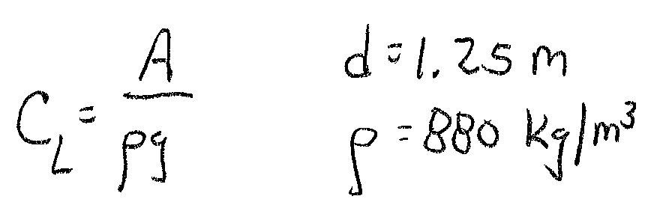
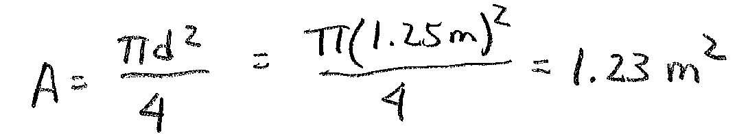
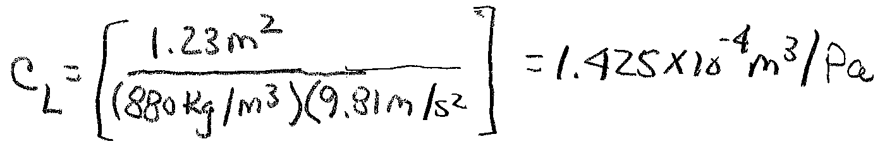
Example 19-1 Solution (1)
From Appendix A
a) Find the tank capacitance

Slide 7
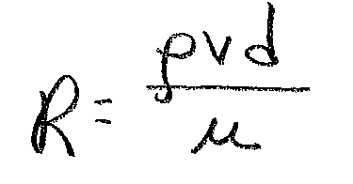
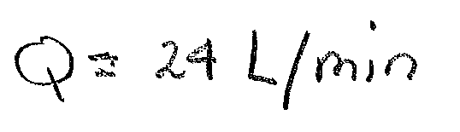
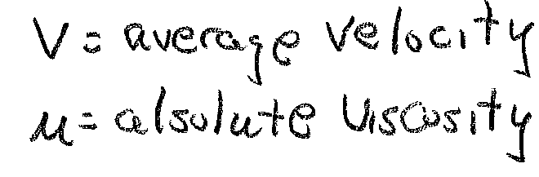
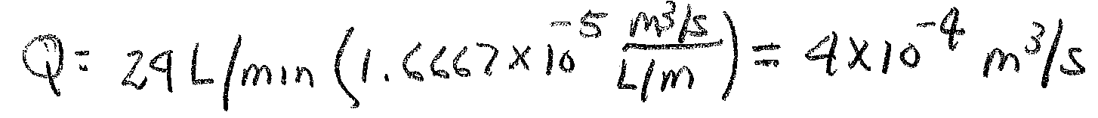
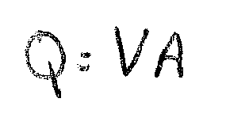
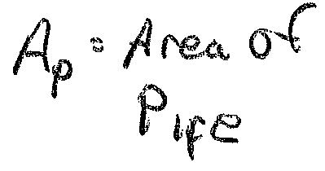
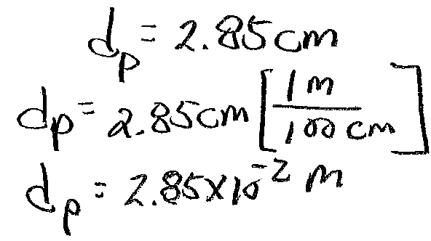
Example 19-1 Solution (2)
b) Find the flow resistance. First compute the Reynolds number to determine flow type. Use maximum flow to determine it.
Convert to
m³/s
Need pipe diameter for its area calculation

Slide 8
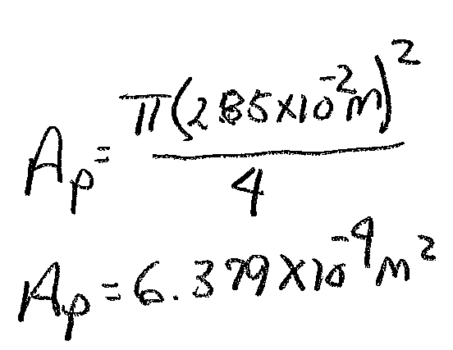
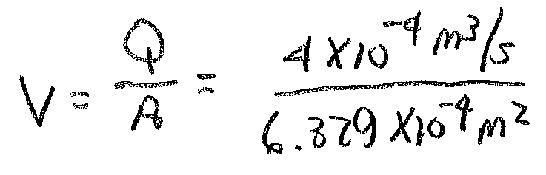
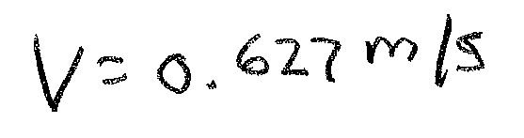
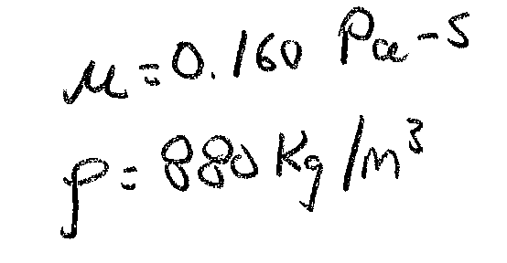
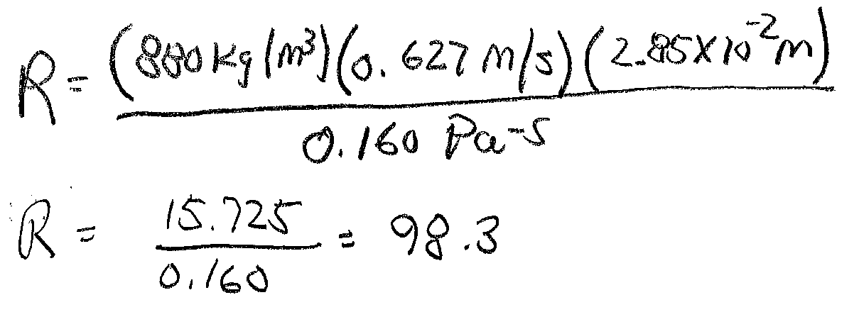
Example 19-1 Solution (3)
Now compute the Reynolds number
Laminar Flow R<2000

Slide 9
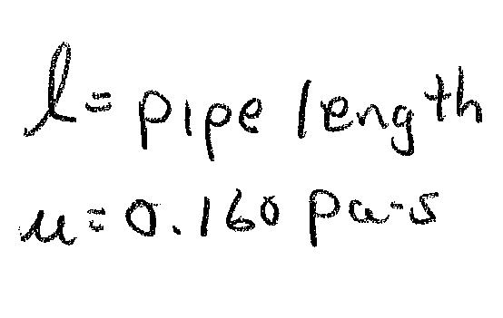
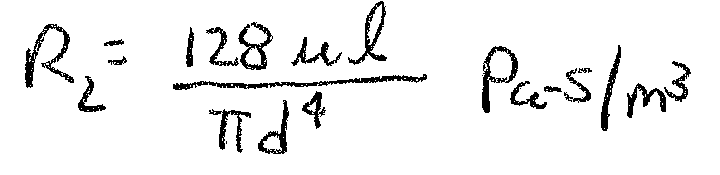
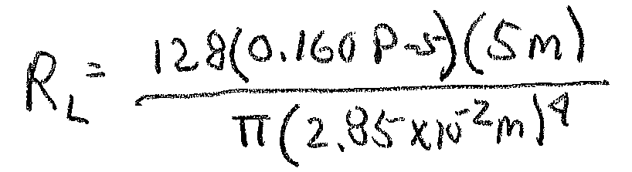
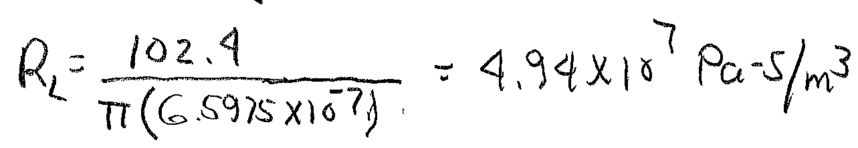
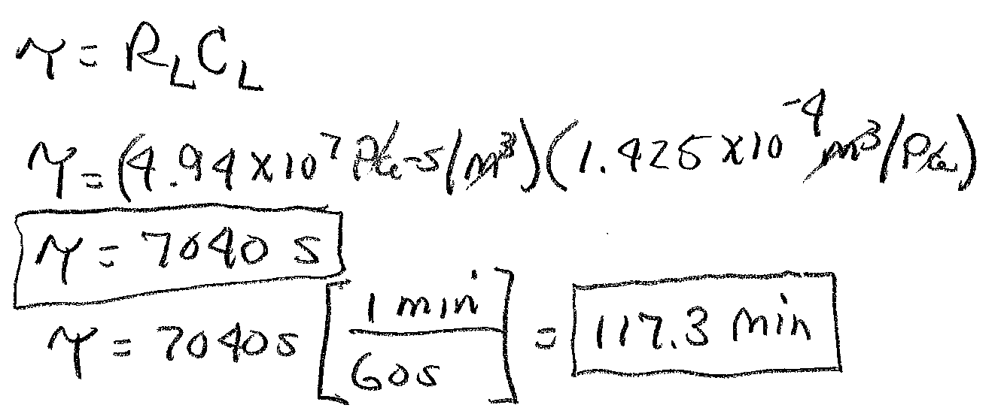
Example 19-1 Solution (4)
For Laminar flow
Now compute the tank time constant
Tank level reduced to 63.2% of
initial value after 117.3 minutes with q_{in}=0. 99.2% empty after 5τ.

Slide 10
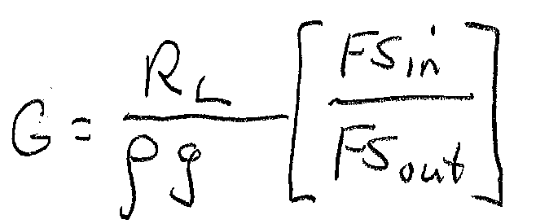
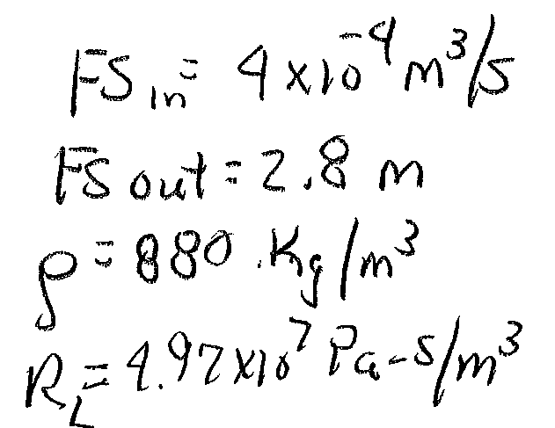
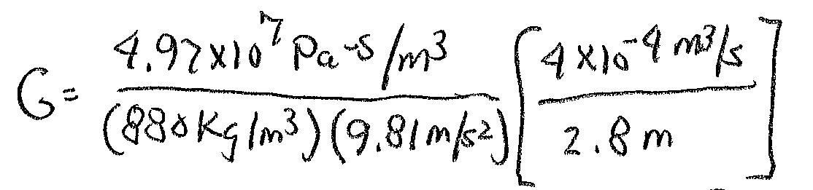
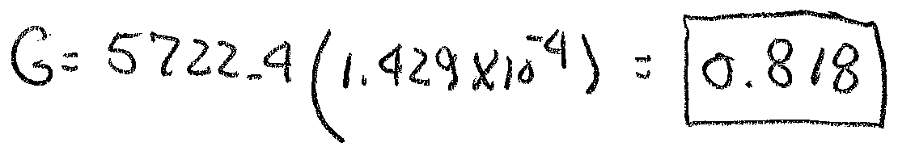
Example 19-1 Solution (5)
d) Compute process gain, G
Ans

Slide 11
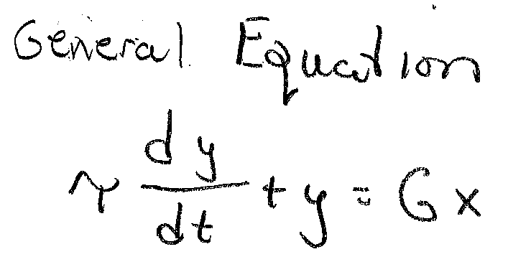
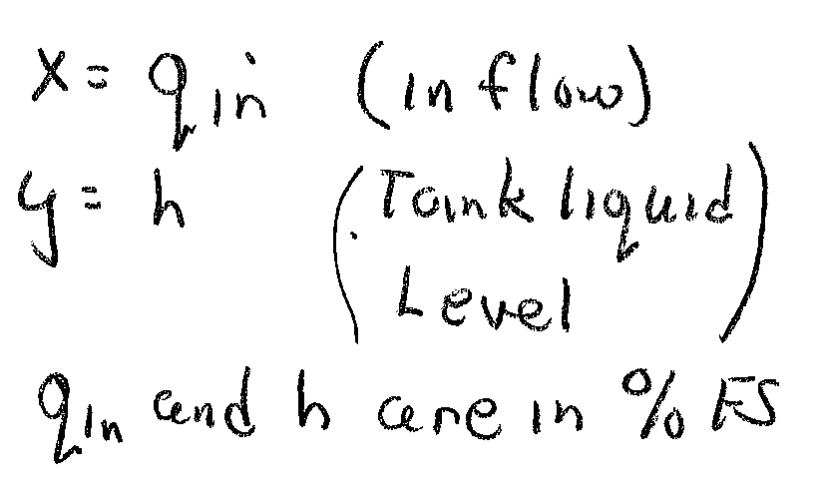
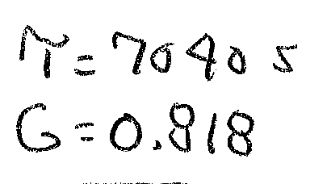
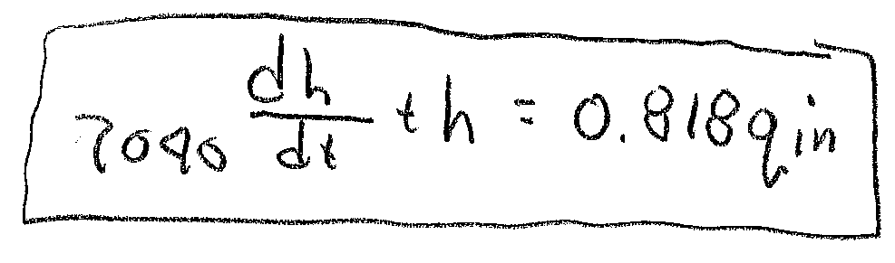
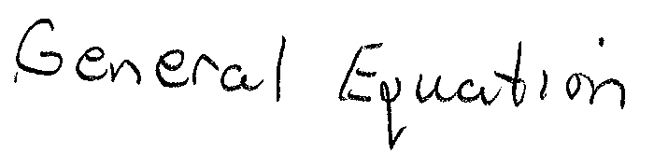
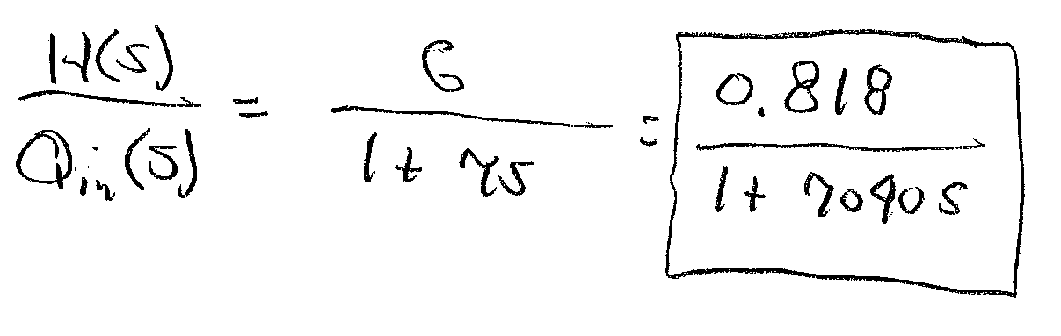
Example 19-1 Solution (6)
e) Find the differential equation for this process
Ans
f) Find the transfer function for this process
Ans

Slide 12
Step Response and Bode Plots of The First-Order Lag Process
MatLAB Code
% close all previous figures and clear all variables
close all;
clear all;
% input the integral time constant
Tl=input('enter the process time constant: ');
G=input('enter the gain of the process: ');
% construct and display the system
sys=tf(G,[Tl 1]);
sys
% plot the frequency response
bode(sys);
% construct a new figure and plot the time response
figure;
% define a range of time
t=(0:500:5*Tl);
% use it to generate a step response plot
step(sys,t);

Slide 13
Step Response of First-Order Lag Example 19-1
0.632(0.818)=0.52
t=7040 s

Slide 14
Frequency Response of First-Order Lag Processes
Similar to low pass
filter plots.
Note the cutoff frequency, f_{c} is when gain is -3 dB from passband f=f_{c}
f_{c}=1/τ = 1.42∙10⁻⁴ rad/sec

Slide 15
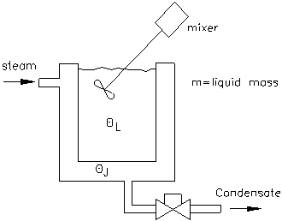
First-Order Lag Process: Thermal Example
Example 19-2: Temperature of oil bath θ_{L} depends on the steam temperature θ_{J} and the thermal resistance and capacitance of the system. The equation below is the general model.
Assume constant steam flow and temperature. The oil-filled tank is 1.2 m tall with a 1 m diameter. The inside film coefficient is 62 W/m²-K and the outside film coefficient is 310 W/m²-K. The tank is made of steel with a wall thickness of 1.2 cm. Find a) thermal resistance
b) thermal capacitance, c) thermal time constant d) differential equation model, e) transfer function model.

Slide 16
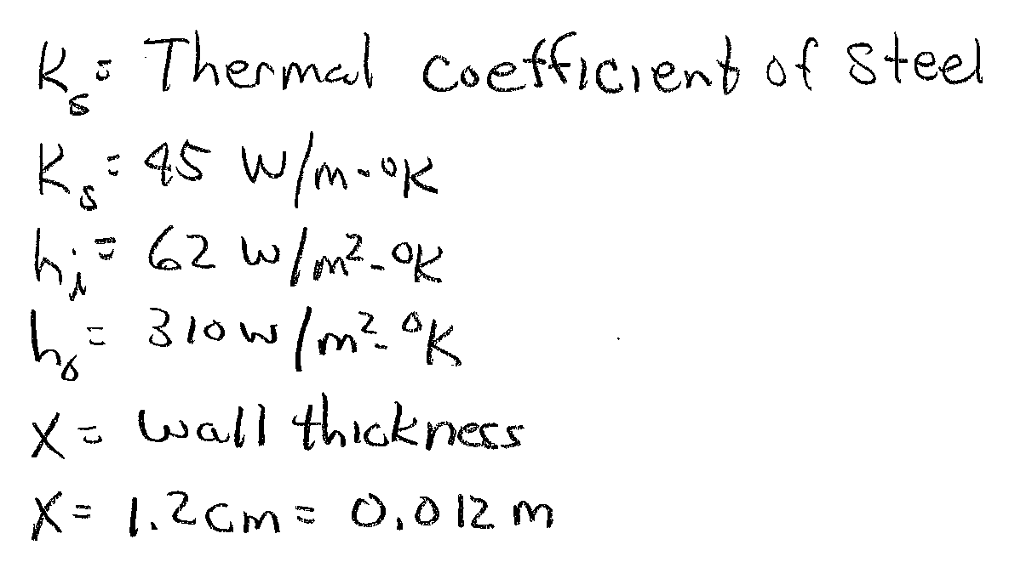
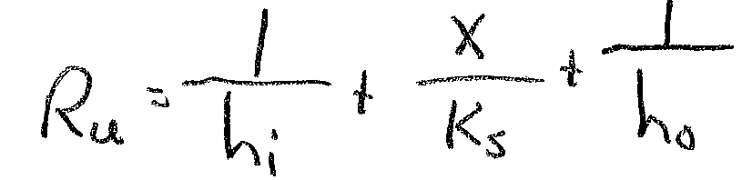
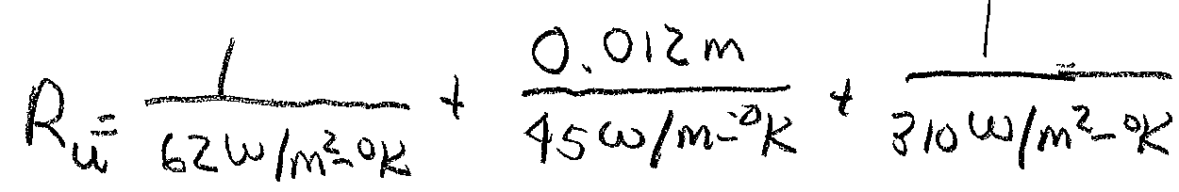
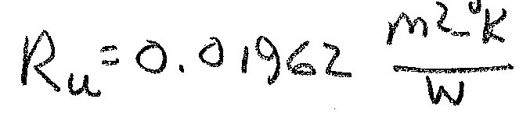
Example 19-2 Solution (1)
a) Compute the thermal resistance
Unit thermal resistance

Slide 17
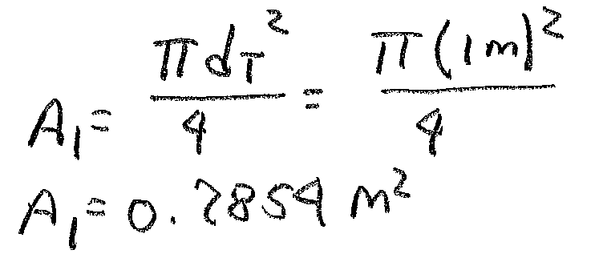
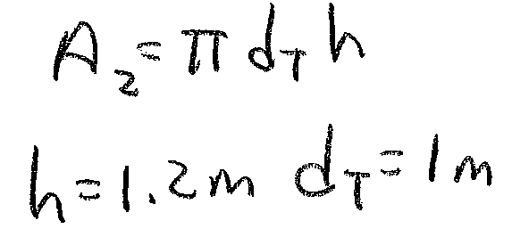
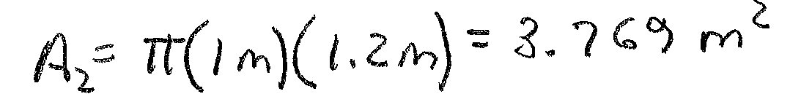
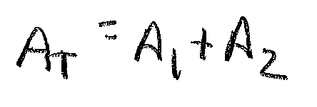
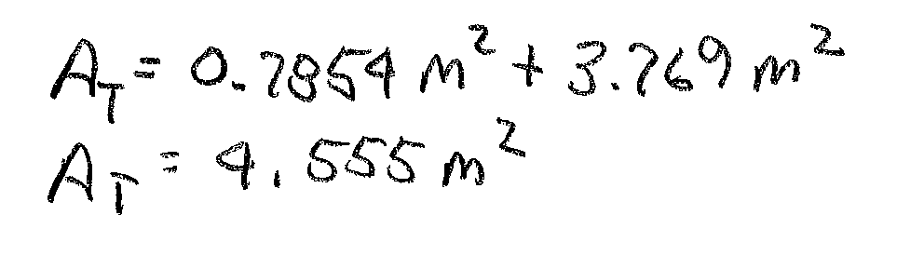
Example 19-2 Solution (2)
Find the surface area of the tank. Assume a circular tank.
Define: A₁ = area of tank bottom
A₂= area of tank sides
Area of sides is area of a cylinder

Slide 18
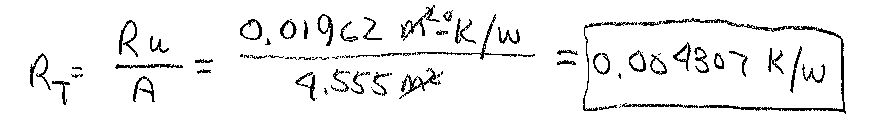
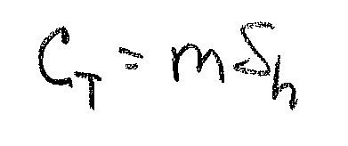
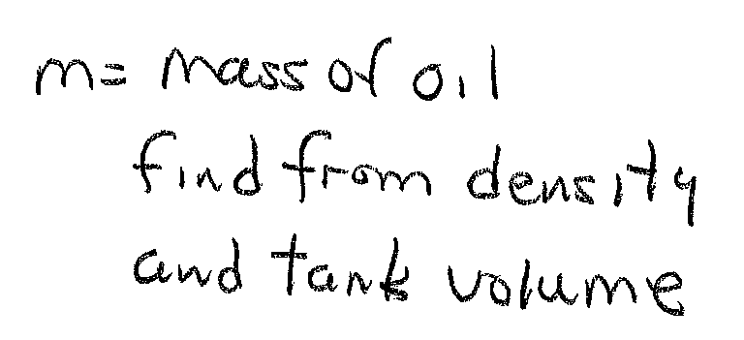
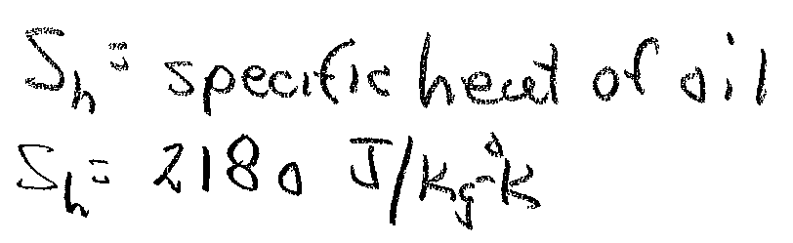
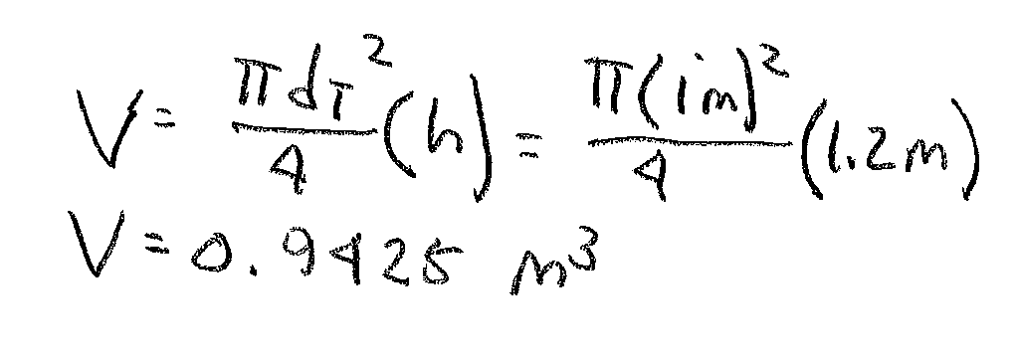
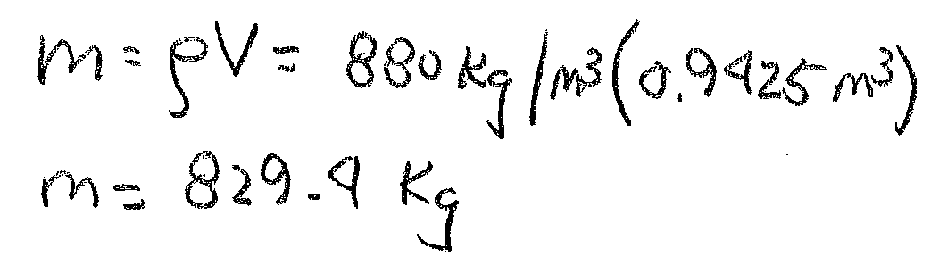
Example 19-2 Solution (3)
Compute total thermal resistance
Ans
b) Thermal capacitance
S_{h} found in Appendix A

Slide 19
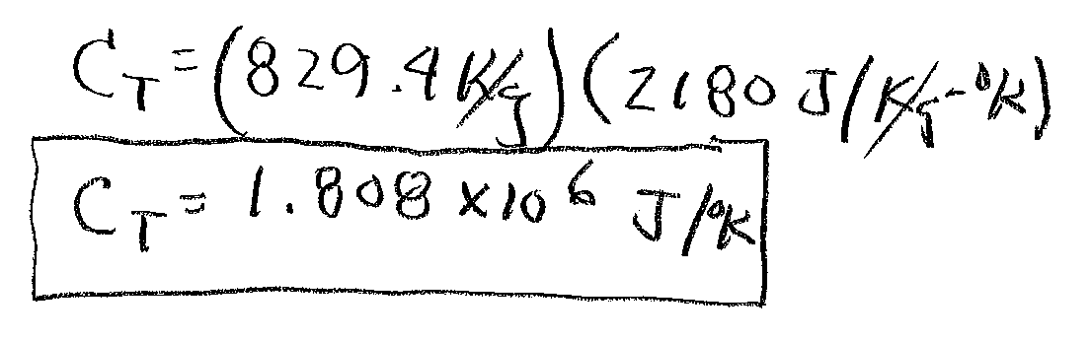
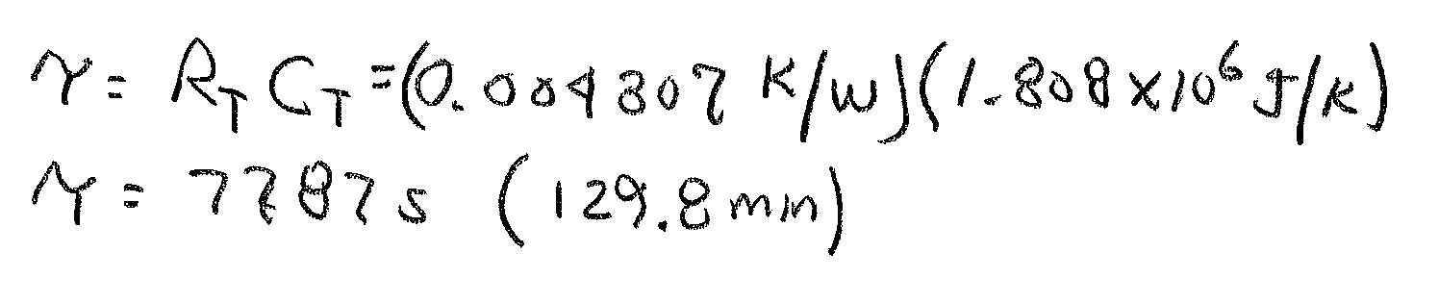
Example 19-2 Solution (4)
Ans
Use the values of R_{T} and C_{T} to find time constant
Step change in input will take 5τ to reach final value.
5τ = 649 minutes (10.82 hours)

Slide 20
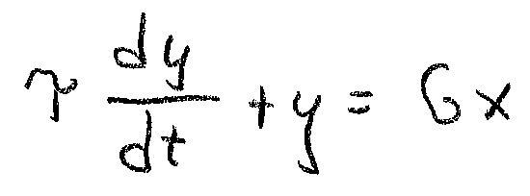
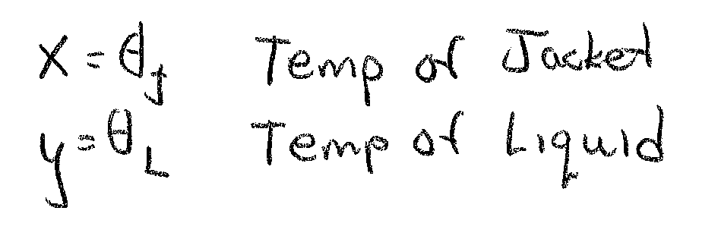



Example 19-2 Solution (5)
d) Find the time function
G=1 in this case so:
Ans
e) Find the transfer function
Ans

Slide 21
Dead-Time Process
Characteristic: Energy or mass transported over a distance
Common in process industries (Chemicals Refining etc)
Time domain equation:
Where:
f_{o}(t) = output function
f_{i}(t) = input function
v = velocity of response travel (m/sec)
D = distance from input to output
t_{d} = dead-time lag (sec or minutes)
F_{o}(s) = Laplace transform of output
F_{i}(s)= Laplace transform of input
Transfer function:

Slide 22

Dead-Time Process
Example: 19-3: Determine the dead-time lag and the process transfer function if the salt-water solution travels at 0.85 m/sec and the distance to the bend is 15 m. Plot the time and frequency response of this system to a step-change in inlet concentration.

Slide 23
Example 19-3 Solution (1)
Define parameters
C(s) is the function describing salt concentration
Compute time delay
Time function:
Transfer function:
Now plot the time and frequency responses

Slide 24

Dead-Time Process Time Plot
t_{d} =17.65 sec

Slide 25
Dead-Time Frequency Bode Plot
Phase increases as frequency increases. Becomes very large for high frequencies.
Gain is constant over all frequencies (0 dB G=1)

Slide 26
End Lesson 19: Process Characteristics-1st Order and Dead-Time Processes
ET 438a Automatic Control Systems Technology

